Slide 1
Eclipse Arrowhead
Roadmap and New Features
Jerker Delsing

Slide 2
Release roadmap
V4.3.0 release April 2021
v4.4.0 release Oct 2021
v5.0.0 planed for Jan 2022
v5.1.0 targeted for april 2022

Slide 3
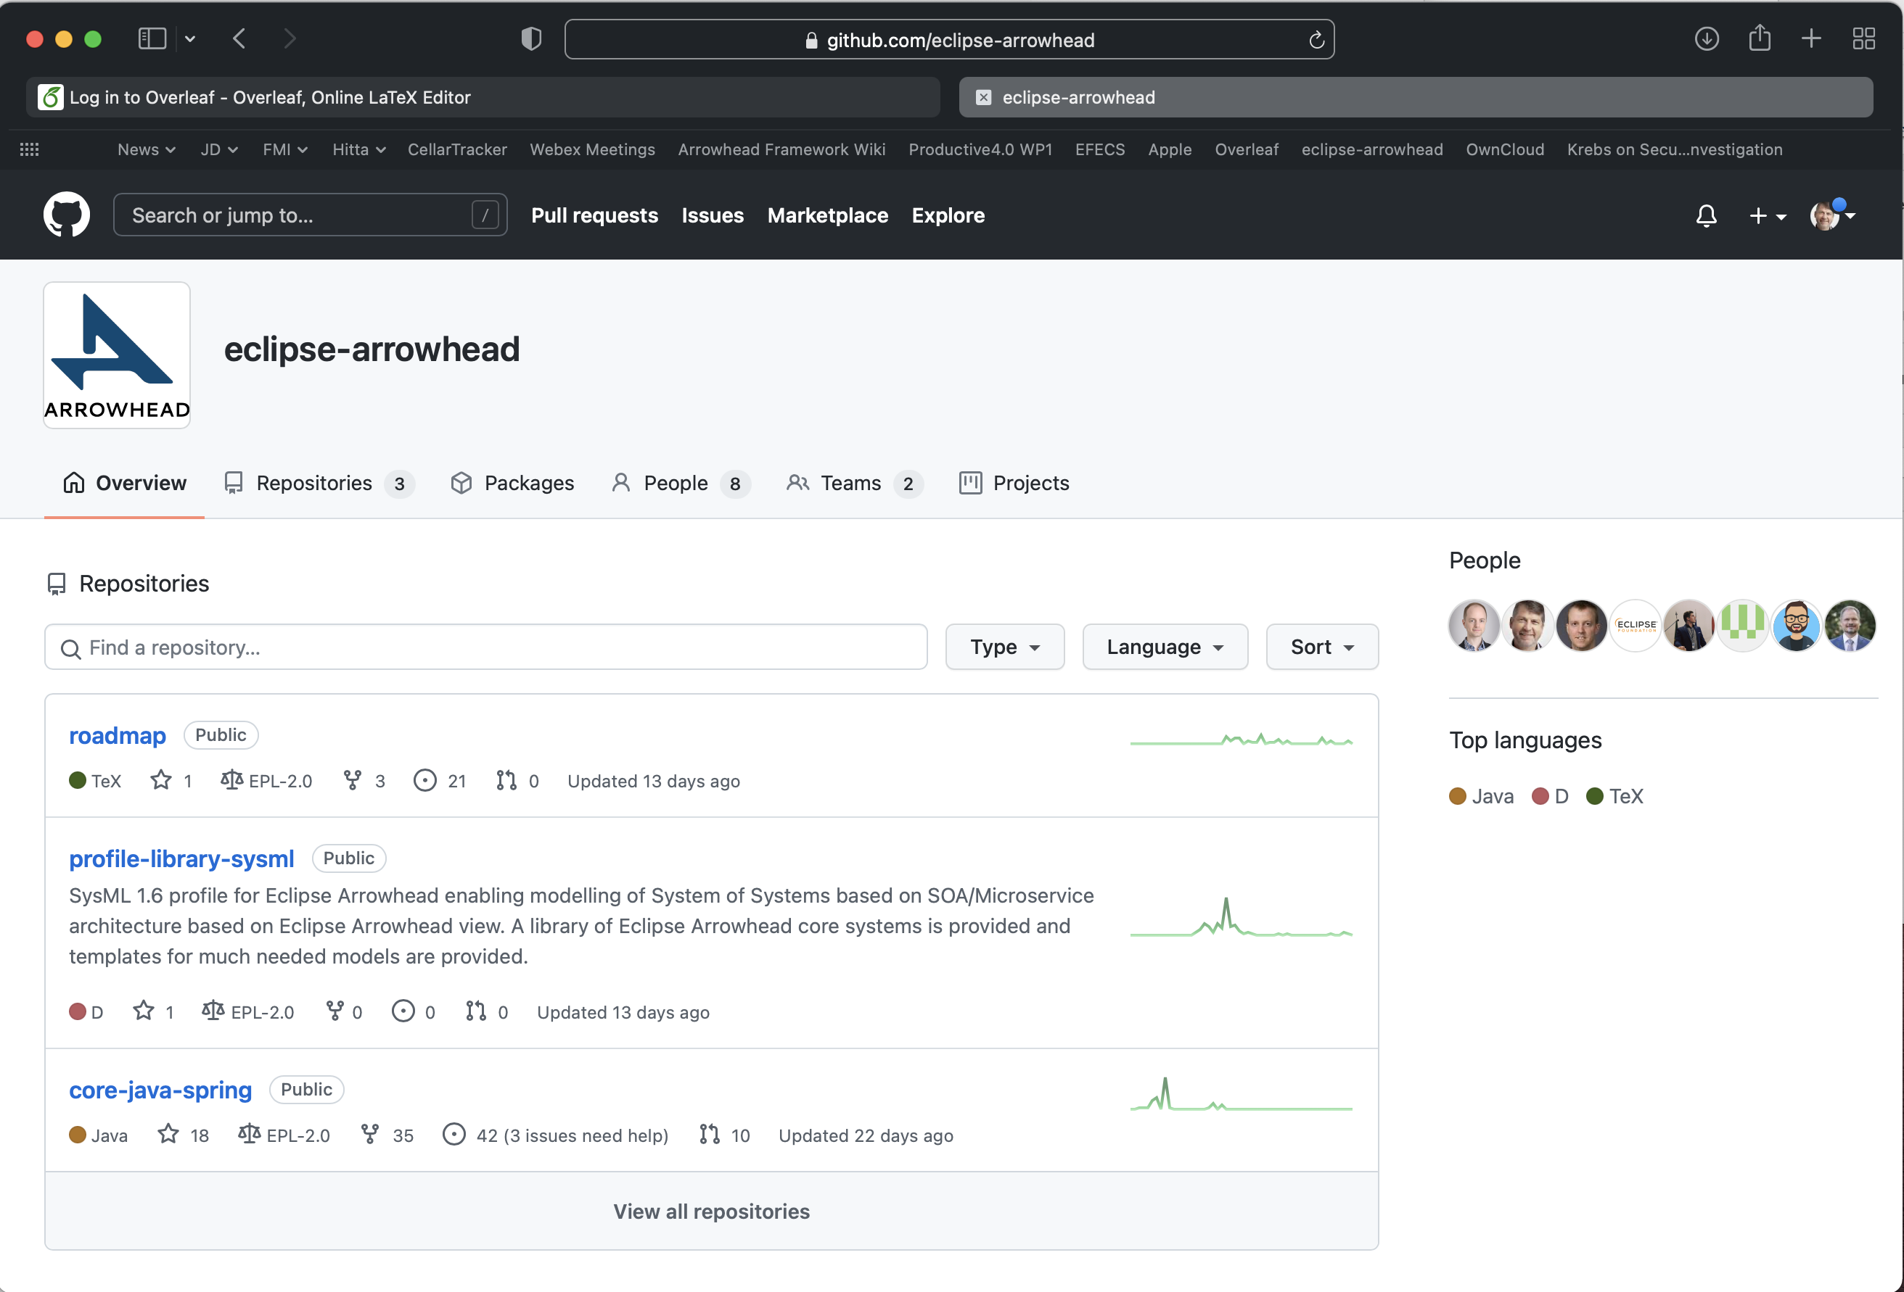
Where

Slide 4
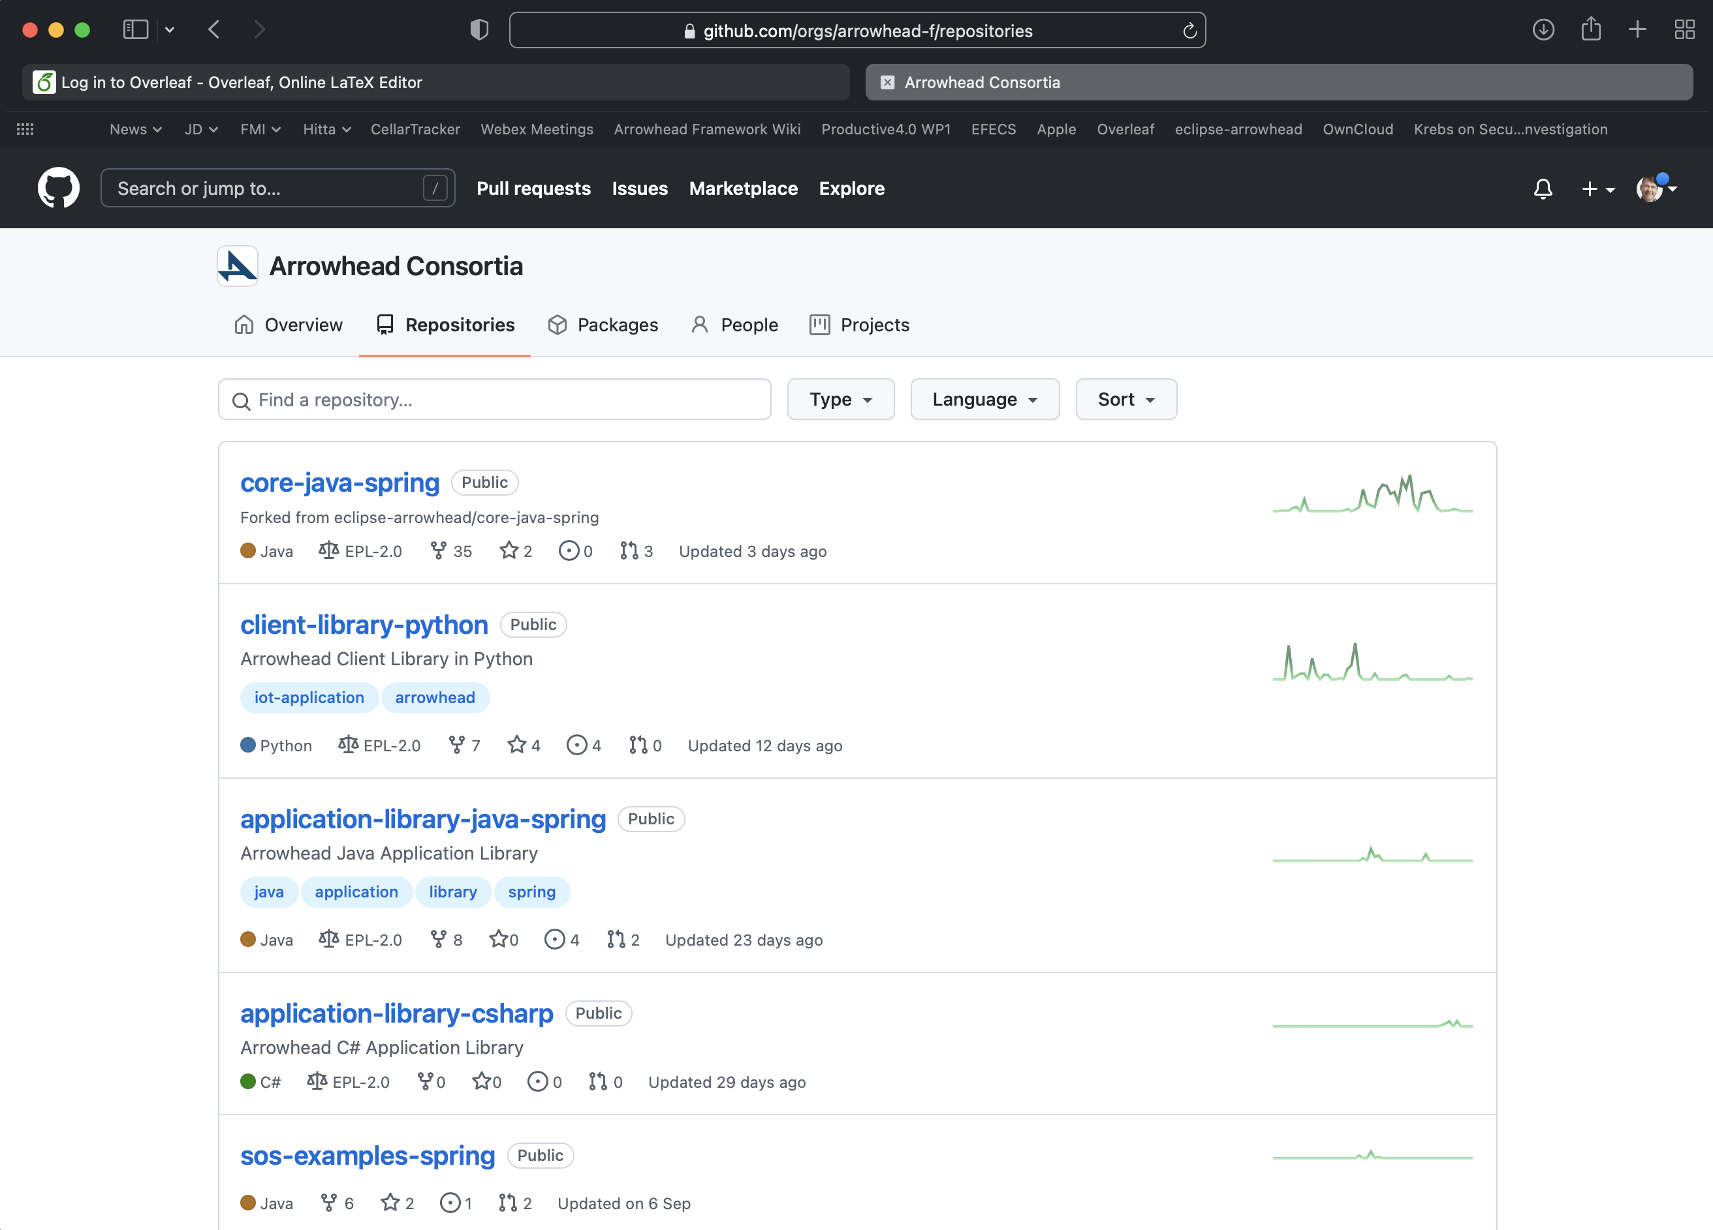

Slide 5
Engineering tools
<<system>>
SysML 1.6 profile
<<system>>
LegacyIntegration
<<system>>
TestTool
<<system>>
SandboxingTool
<<system>>
ConsumerCodeGen
<<system>>
Eclipse-Vorto
<<system>>
SysML 2 profile
<<system>>
Installation
<<system>>
CI/CD pipeline
<<system>>
Python lib
<<system>>
Kalix lib (Java)
<<system>>
C++, C#, .net lib
<<system>>
Eng process
<<system>>
Tool chain interoperability
Management support:
<<system>>
ManagementTool
<<system>>
SafetyManager
<<system>>
SecurityManager
<<system>>
Eclipse-Ditto
<<system>>
Training material
Supply chain/product life cycle
<<system>>
Contract Proxy
Released
Execution support
<<system>>
Choreography
<<system>>
WorkflowManager
<<system>>
WorkflowExecutor
<<system>>
WSO2+CPN
<<system>>
OrchestrationMitigation
Release candidates
Control support
<<system>>
ControlStrategy
Prototypes
System of Systems support
<<system>>
PlantDescription
<<system>>
Configuration
<<system>>
SecurityMitigation
Eclipse Arrowhead v4.4.0
<<system>>
TimeManager
<<system>>
QoS
<<system>>
Eclipse-Hono
Separately released
<<system>>
EventHandler
<<system>>
DataManger
<<system>>
Eclipse-hawkBit
<<system>>
Eclipse-Kura
<<system>>
Eclipse-Kapua
Inter cloud service exchange
<<system>>
Gatekeeper
<<system>>
Gateway
Interoperability
<<system>>
Translation
<<system>>
FiWare
<<system>>
61499
<<system>>
ModbusTCP
<<system>>
OPC-UA
<<system>>
BaSyx
<<system>>
ROS
<<system>>
Semantics
Security infrastructure:
<<system>>
SystemRegistry
<<system>>
DeviceRegistry
<<system>>
On-boarding
<<system>>
SecurityCompliance
<<system>>
Keycloack
Local cloud basic properties:
<<system>>
ServiceRegistry
<<system>>
Authorisation
<<system>>
Orchestration
<<system>>
CertificateAuthority

Slide 6
Where to find
www.github.com/eclipse-arrowhead
www.github.com/arrowhead-f

Slide 7
Active roadmap discussions

Slide 8
Roadmap discussions
www.github.com/eclipse-arrowhead/roadmap

Slide 9
Eclipse Arrowhead
Roadmap WG
Agenda 210915

Slide 10
Agenda (MoM from last meeting in red)
v4.4.0 release - what can be released now? On its way waiting for Eclipse review.
CI/CD + Jenkins server for generation of packages for different OS and HW. Will continue after the 4.4.0 review.
Move of code from arrowhead-f to eclipse-arrowhead Move only IP okayed by Eclipse repositories and working with v4.3.0. Naming convention of repository names. Proposal of names and repos to move. First lib approved to move by Wayne Breton
Lowering the entry step - status reports
Gabor - VirtualBox on any environment, core systems + providers and consumers. The virtual box environment is updated to the 4.4.0 version. Work in progress. Time line is a first try out version within Sept. Demo at Lubeck.
Emanuel - Device daemon, Local cloud deamon, Local cloud management - will work on this as consultant to LTU
Cristina - From models to code and deployment - Plugin to IDE and Papyrus to select Local clouds and systems you like to include, current development of producers and consumers. Working on plug-ins use connection to generate SQL scripts to populate the Orchestration store with such info. Presentation at next bi-weekly and Lubeck.
Documentation strategy Mats proposed a discussion on documentation strategy. We may move from text documents to some type of tool which can be used for validation of implementation. A move in this direction is a future point. When to push this is still an open question.
Walk through current discussion points - Jerker
Issue lists in GitHub
Issue in Roadmap to be created by Szvetlin regarding on data base question for ServiceRegistry, SystemRegistry, DeviceRegistry, ….
Issue on Changelog/release-note is moved to Roadmap from java-spring-core directory.
arrowhead.eu certificate server, #302 proposal from LTU in a couple of weeks time
Eventhandler discussion, Gabor to start an issue in the Roadmap repo
Next meeting: Oct. 28 at 15.00 - 16.30

Slide 11
Eclipse Arrowhead architecture - core systems
How shall serviceConsumers be registered in SystemRegistry? WG report by Jan. Initial discussion started. Discussion will be hosted as an issue in GitHub roadmap repo. Targeted for decision at Lubeck WS. BnearIT open the discussion on use of other ServiceRegistry like CONSUL. CONSUL is the leading open source ServiceRegistry. Supports high availability through a number of means.
MetaData, mandatory and optional, for Service, System and Device registries?
Proposal for discussion from Cristina. Cristina and Jerker to prepare a discussion for the Roadmap WG, time line end of August. Eventual integration with ServiceRegistry WG.
Necessary updates to Orchestration and Authorisation system -
Arrowhead X.509 certificate documentation as part of Authorisation SysDD - #11, Emanuel reported. Requirements is currently being discussed.
Format for Orchestration policy and Authorisation policy data, Jerker to ask Ulf/Olov to prepare a Roadmap WG discussion in the topic. Still to be made.
GateKeeper and Gateway systems
Scenarios for § 4, 5, and 6, Mario sequence diagram from Marios scenario 2a. Contact to WAPICE and BnearIT, look for decision next meeting. Jerker to extend the dialog with Fredrik B (BnearIT) - Mario to check in resources for hosting a WG.
Possible change of core system database - ON HOLD
Light database is a request - WAPICE, On hold until item 1.1 is a closed

Slide 12
The big picture

Slide 13
Eclipse Arrowhead roadmap - big picture
Core systems
Fundamentals, Robustness, Documentation
Interoperability
Packages
Libraries
Engineering
Extensions - new or updated core systems
Traning

Slide 14
Core systems - Fundamentals
ServiceRegistry - v5.1.0?
SystemRegistry, DeviceRegistry
Other protocols
Use of other ServiceRegistries e.g. Consul
Robustness
Local cloud monitoring and management
Arrowhead Device Agent - v5.1.0 Emanuel
Arrowhead Device Supervisor - v5.1.0 Emanuel
Virtualisation of resources, e.g. mandatory core systems

Slide 15
Core systems - Fundamentals
Documentation - updates ready for V5.0.0 release
Fundamentala concepts in Arrowhead,
Arrowhead relations to Reference Arhictecture Model Industrie 4.0 (RAMI4.0),
Arrowhead in relation to OASIS Reference Architecture Foundation for [SOA]
Reference list to publication e.g.
IoT Automation: Arrowhead Framework (Delsing, 2017)
….
Arrowhead Documentation Reference

Slide 16
Interoperability
Adaptors
OPC-UA, Aparajita - v5.0.0
Z-Wave, Salman - v5.0.0
Modbus-TCP, Salman - v5.0.0
IO-link, Infineon/HTW - v5.0.0

Slide 17
Packages
HW/OS | Linux | Windows | OS-X
Desktop
Laptop
Raspberry PI
STM32

Slide 18
Libraries
Move of libs from www.github.com/arrowhead-f
to www.github.com/eclipse-arrowhead in process fully done for v5.0.0
Java
Kalix
C# .net
C++

Slide 19
Engineering
Simplicity - lowering the entry step: Code developers
Arrowhead Device Agent - v5.1.0 Emanuel
Arrowhead Device Supervisor - v5.1.0 Emanuel
Graphical local cloud management tool - v5.x.0 Emanuel
VirtualBox on any environment, core systems + providers and consumers - v5.0.0 Tamas
Engineering automation: Automation/solution engineers
SysML models to executable code - v5.0.0 Cristina
Application system from SysML to code - v5.0.0 Saadia, Fawda, Cristina
On-line SysML tool - v5.1.0 Geza

Slide 20
Engineering
Engineering process - v5.0.0
Documentation - Gianvito/Jan
Tools chains - v5.0.0
Documentation - Marek/Federica
SysML
Papyrus profile and library SysML1.6 - v5.0.0 Fawda
MagicDraw SysML 1.6 updates - v5.0.0 Jerker

Slide 21
Extensions - new or updated core systems
ContractProxy enabling M2M business - v5.1.0 target
Workflow management and execution - v5.1.0 target
WorkflowManager, Workflow Executor - Jaime
Choreography updates - Daniel
NodeRed - Felix
Autonomous re-orchestration - Hua
Security
X.509 profile - V5.0.0 Emanuel
Security mitigation tool - v5.0.0 Silia/Mario
Security compliance tool - v5.0.0 Silia/Mario
NGAC - v5.1.0?

Slide 22
Extensions - new or updated core systems
Integration/Interaction with Eclipse projects
Eclipse HawkBit - v5.0.0 Bosch Lucas
Planed
Eclipse Hono - v5.1.0 Bosch
Eclipse Vorto - v5.1.0 Bosch
Eclipse Kura - v5.1.0 EuroTech
Eclipse Kapua - v5.1.0EuroTech
Eclipse 4diac - update to latest Arrowhead version

Slide 24
Training
Studio4Education - v5.0.0 Sebastian
Training catalog - v5.1.0 Emmanuel
Literature
Tools
Videos

Slide 25
Web resources - targeted audience
High level introduction: Managers and application developers
arrowhead.eu/eclipse-arrowhead
Application and Code developers
eclipse.org/arrowhead
Code developers
GitHub.com/eclipse-arrowhead

Slide 26
Long term
Semantics interoperability

